Slide 1
MKT 562 COURSE PROJECT POSITIONING STRATEGY FOR FILA
TEAM 1: Ben Jose, Ishika Gupta, Nikhil Reddy Guddeti Venkata, Supriya Prasad, Tien Le-Dinh, Upmanyu Tyagi
Notes:
Good morning to one and all present here. Today my team and I will be our presenting our final course project for the MKT 562 class.

Slide 2
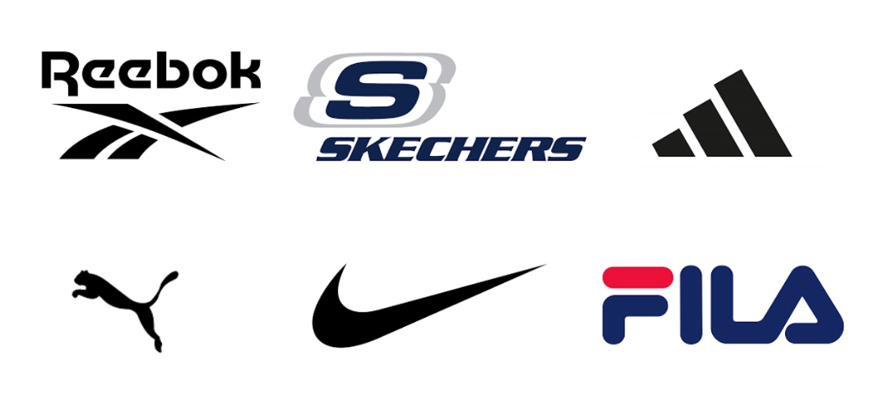
Background / PROBLEM STATEMENT
FILA – Italian-South Korean sportswear and footwear company.
Founded in – 1911 in Biella, Italy by the Fila Brothers
Notes:
Sport shoes play a critical role in enhancing athletic performance, provide comfort and protection for individuals who are engaged in various physical activities. For this project, we are trying to provide an effective positioning strategy for one of the sport shoes brand, FILA. FILA is an Italian-South Korean sportswear and footwear company. It was founded in 1911 in Biella Italy by the FILA brothers. Despite being a renowned brand, FILA faces fierce competition from industry giants such as Nike, Adidas, and Reebok. We want to analyze FILA’s and its competitors' strengths and weaknesses to enhance its market position.

Slide 3
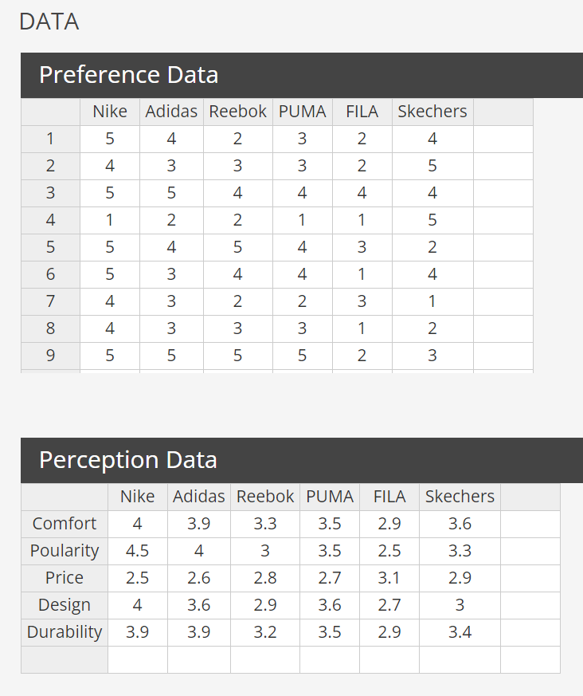
COLLECTING DATA
6 brands
FILA
Nike
5 attributes
Comfort
Price
1- 5 Rating scale
1 – lowest / least preferred
5 – highest / most preferred
Adidas
Reebok
PUMA
Skechers
Durability
Popularity
Design
Focal Brand
FILA
Notes:
The first step to perform any kind of data analysis is to collect the data. We created a google form and sent it out to know people’s preferences and perceptions about 6 major shoe brands – Nike, Adidas, Reebok, PUMA, FILA, and Skechers. We asked everyone to rate each of the 6 brands in terms 5 key attributes – comfort level of the shoe, how popular they think it is, how pricy they think it is, how its designs are, and what they think of its durability. We asked them to rate their preferences from a scale of 1 to 10. 1 being the lowest or least preferred and 5 being the highest or most preferred. A little about the demographic information about the people who filled out our survey – they are young / youthful people. Once we had the data, we cleaned it up and organized it as preference and perception data so that we can run our analysis on Enginius. We had to aggregate every respondent’s rating for each brand-attribute combination to get the perception data.

Slide 4
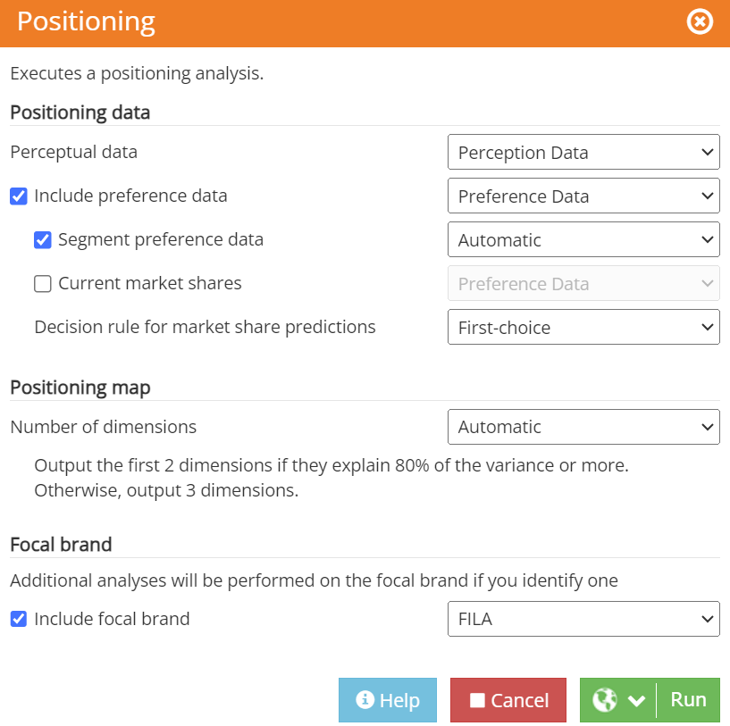
RUNNING THE SIMULATION
Notes:
We ran a positioning analysis on Enginius based on our preference and perception data. We asked it to perform segmentation on our preference data and automatically decide what the appropriate number of segments should be. We also asked it to automatically decide the number of principle components that should be used.

Slide 5
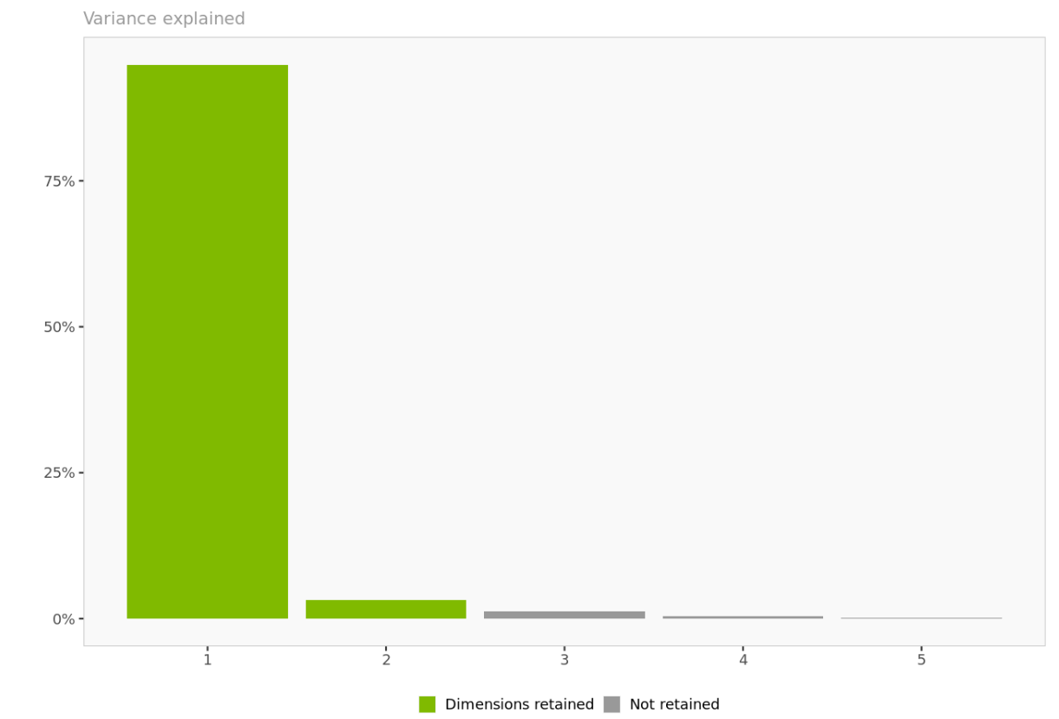
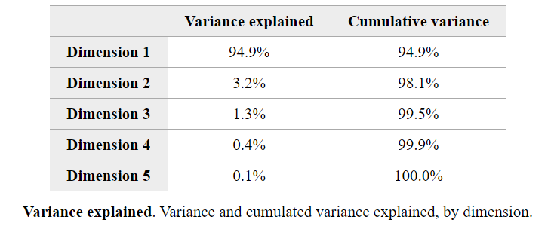
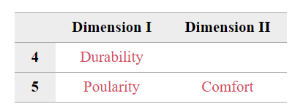
PRINCIPLE COMPONENT ANALYSIS
Retaining only the first 2 dimensions – They explain 98.1% of the variance.
Dimension – 1: Durability and Popularity
Dimension – 2: Comfort
Notes:
So here are the results from our positioning analysis. From 5 dimensions, we are retaining the first 2 dimensions / principal components. The first dimension captures 94.9% of the variance and the second dimension captures 3.2% of the variance. Together, these 2 components capture 98.1% of the variance in our data. The attributes that most closely represent dimension 1 are durability and popularity. Dimension 2 represents comfort.

Slide 6
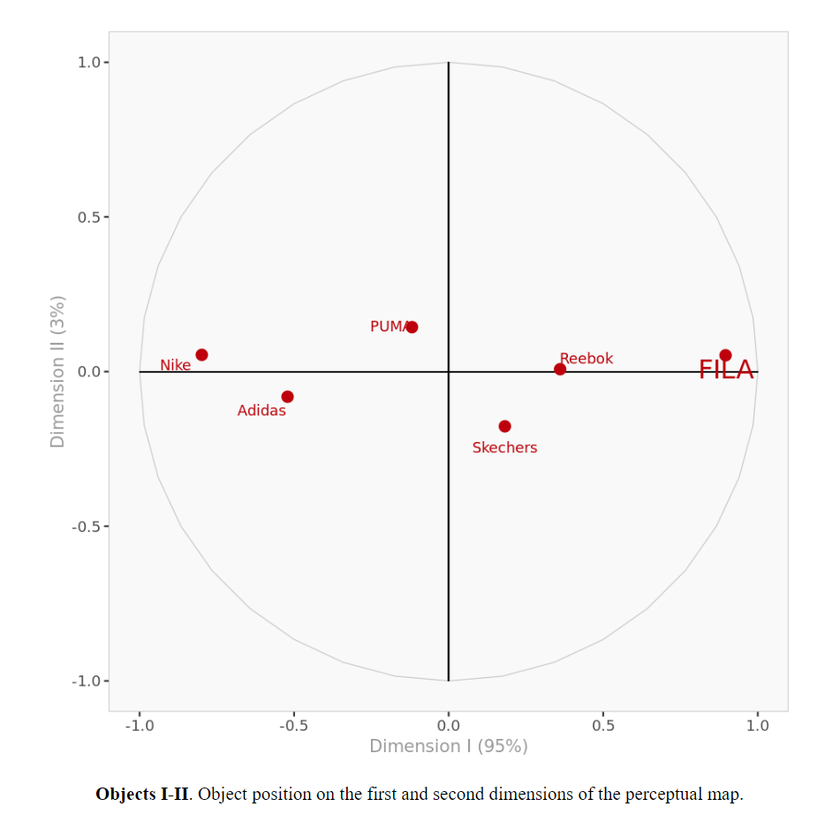
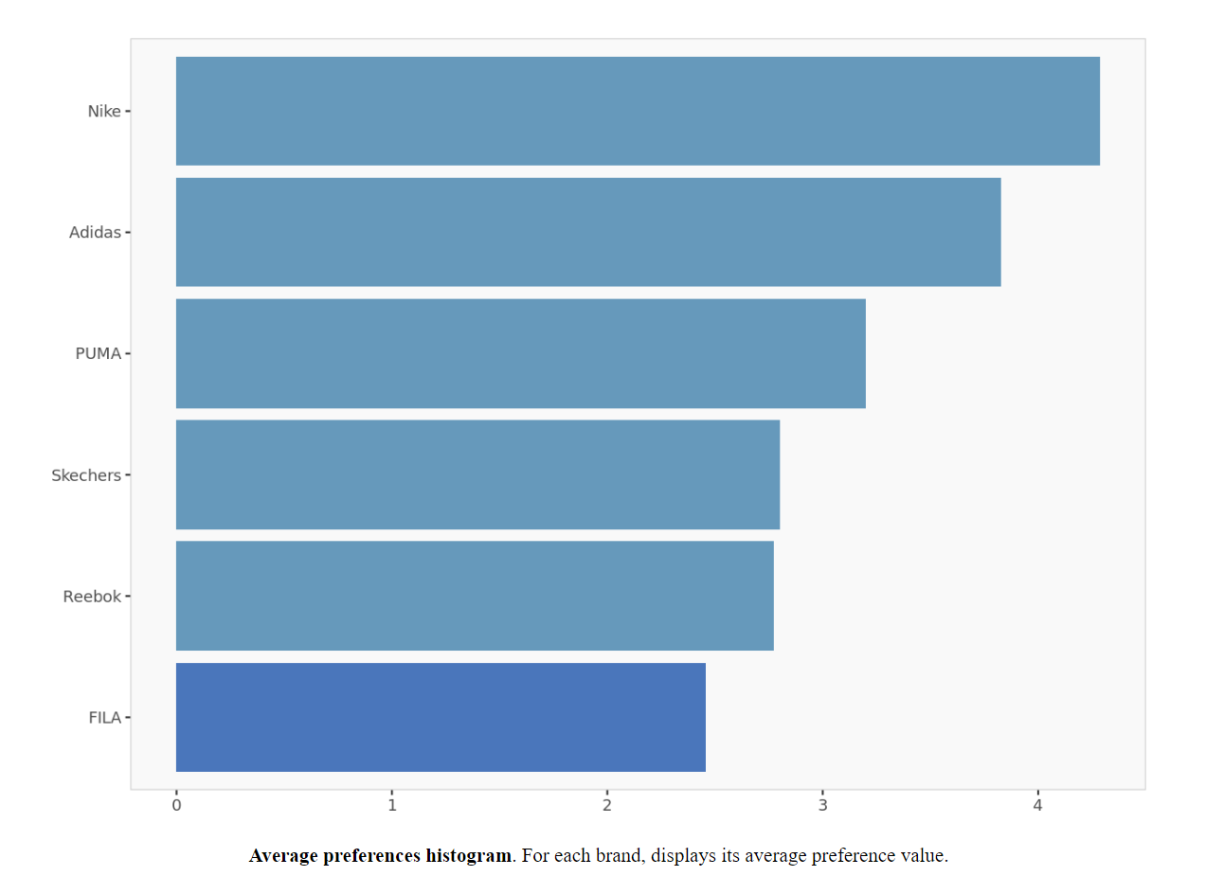
ANALYSIS
Focal company – FILA
FILA’s closeset competitors: Reebok and Skechers – Since they are the closest neighbors of FILA
FILA is the least preferred shoe brand when compared to Nike, Adidas, PUMA, Skechers, and Reebok – It is at a bad position right now.
Notes:
If we look at the object map on the left we see that FILA’s closest competitors are Reebok and Skechers. This is because points on the object map that are close to each other are perceived to be similar to each other. Nike, Adidas and PUMA are then considered pretty similar to each other. On the right, we see the average preference of each brand and we can see that FILA is the least preferred brand amongst all others. The most preferred brands are Nike and Adidas.

Slide 7
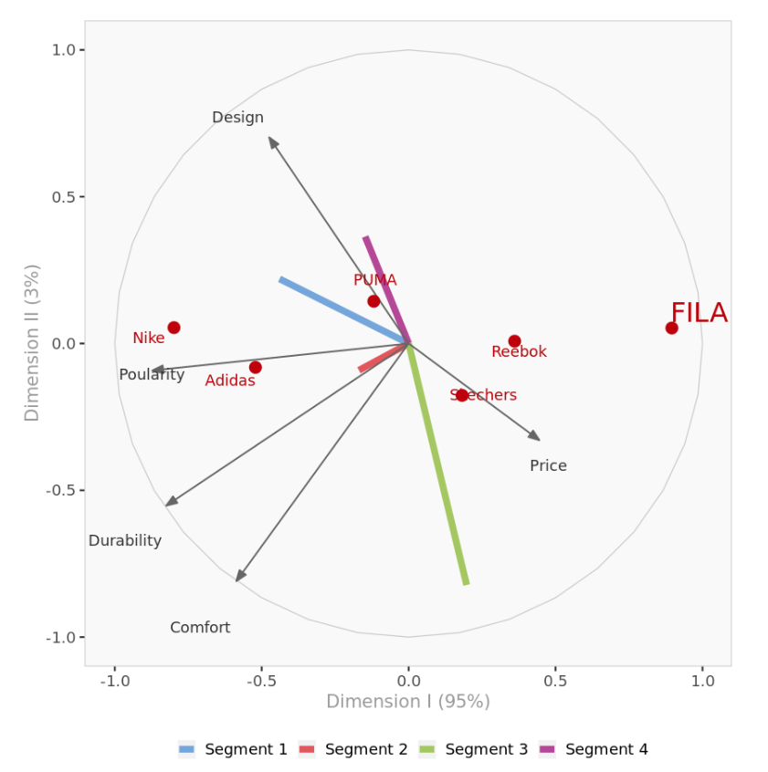
ANALYSIS
Strengths and weaknesses of FILA
STRENGTHS | WEAKNESSES
Price Competitiveness | Design and Popularity
 | Durability
 | Comfort
Strengths and weaknesses of Reebok and Skechers
STRENGTHS | WEAKNESSES
Design and Popularity | Price
Durability (Skechers)
Notes:
So, what are the strengths and weaknesses of FILA and its competitors? When we look at the projections of FILA, Reebok, and Skechers on various attributes, here is what we observe, Price: FILA, Reebok, and Skechers are cheap (have good prices) when compared to Nike, Adidas, and PUMA
FILA is the cheapest (has the best prices) amongst Reebok and Skechers.
Design and Popularity: FILA, Reebok and Skechers are not considered to have good design are not really popular – FILA having the worst designs and being the least popular.
Durability: Skechers is considered to be more durable when compared to Reebok and Skechers – FILA having the worst durability.
Comfort: Skechers is considered to be more comfortable when compared to Reebok and FILA. FILA is considered the least comfortable.
We can conclude that FILA is the most affordable brand – making it an attractive choice for budget-conscious consumers. But, FILA faces a lot of challenges in terms of its design aesthetics and popularity. We can say that FILA is not doing a good job at in terms of innovation and raising brand awareness. It is also considered to be the least durable. All these problems could impact customer satisfaction and loyalty. Reebok and Skechers, on the other hand, are considered to have better designs and are more popular than FILA. This means that these brands have successfully resonated well with customers in terms of design and brand image. They are also considered more durable than FILA, attracting customers who desire long lasting shoes.

Slide 8
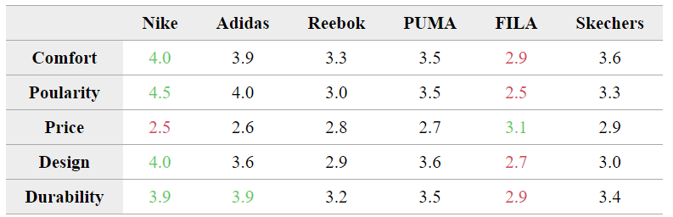
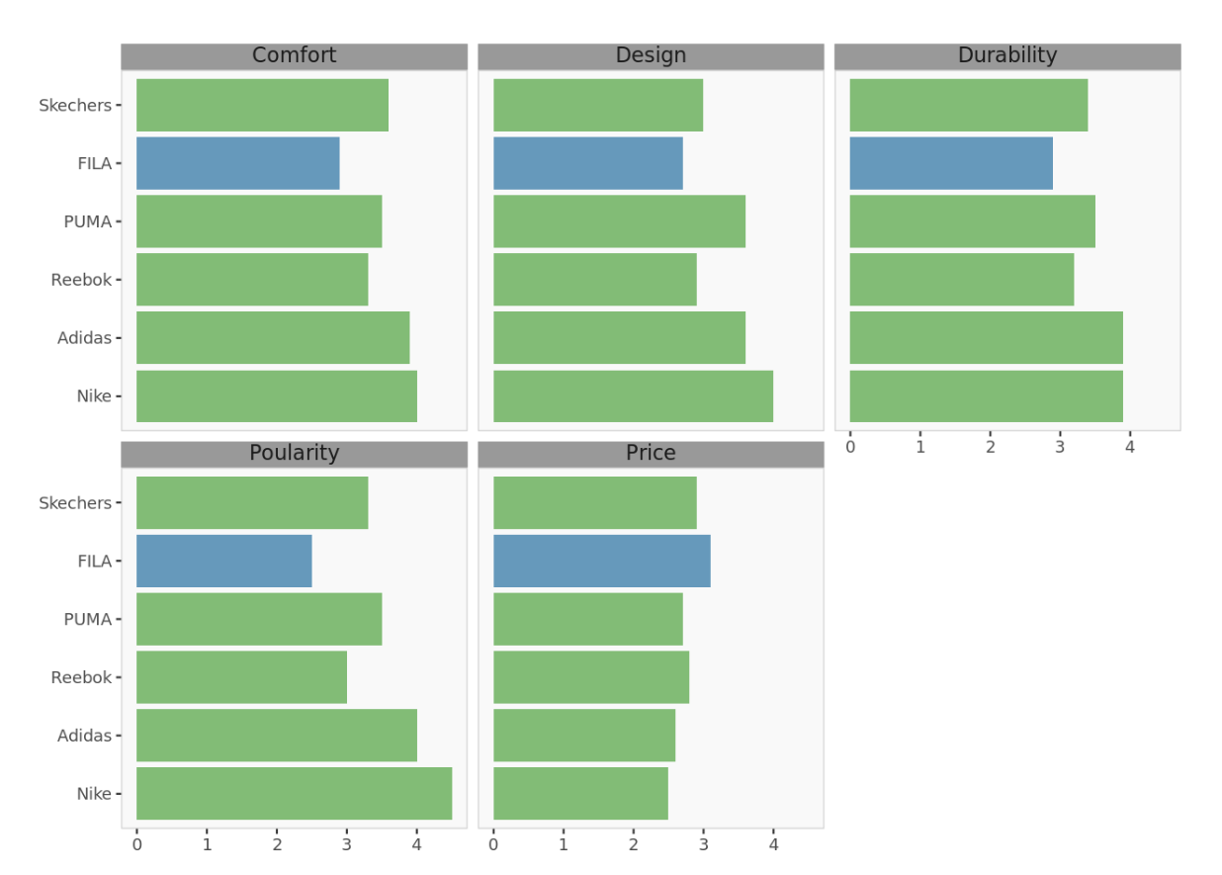
ANALYSIS
Nike | Adidas | FILA
Strong brand image | Better durability than all other brands | Most affordable
Expensive |  | Does not meet customer expectations for comfort, style, durability.
Notes:
Lets take a look at Nike and Adidas as well.
Nike: Its comfort, popularity, design and durability is considered to better than all the other brands. But it receives a very low rating on price – indicating that it has a good brand image but is expensive.
Adidas: Its durability is considered to better than all the other brands.
FILA: It is considered the worst in terms of comfort, popularity, design and durability. The only good thing that it has going on for it is the price. It has the best rating for price – which means that it is considered to be the most affordable.

Slide 9
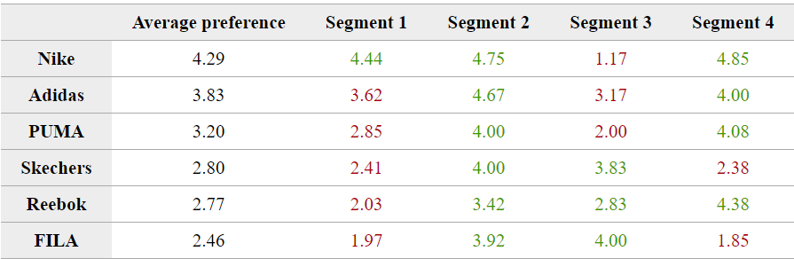
SEGMENTATION
Segment 1
Nike Enthusiasts
Value brand image and quality
Segment 2
Pragmatic Shoppers
Not Brand loyal
Segment 3
Affordability Seekers
Price is a significant factor
Segment 4
Both price and brand image play an important role
Brand influenced budget shoppers
Notes:
Everyone knows that mass marketing does not always work. And marketing a product differently for each and every consumer turns out to be very expensive – in terms of time and money. The best way to market any product is to segment the market and provide a different marketing strategy for each segment. From our analysis, there are 4 major segments.
Segment 1
Segment 1 has a strong preference for Nike, likely due to it being popular, comfortable, durable , and its endorsement by iconic athletes. Despite its high price, the brand equity of Nike is very strong in this segment, indicating that these customers value brand image and quality over cost.
Segment 2
Segment 2 is not brand loyal and seems to have a more pragmatic approach to purchasing shoes. They are likely influenced by factors such as colour coordination with clothes, availability, rather than brand prestige or other attributes.
Segment 3
Segment 3 prefers brands like Skechers, Reebok, and FILA, which are considered more affordable. Price is a significant factor for this segment, suggesting that they are price-sensitive customers looking for functional and economical options.
Segment 4
Segment 4 shows distaste towards Skechers and FILA. Reebok, despite being similarly priced, enjoys a slight edge in popularity, perhaps due to its marketing and athlete endorsements. This indicates that even among more price-sensitive customers, brand perception can influence preferences.

Slide 10
POSITIONING STRATEGY
Product Development and Innovation
Attract customers from segment 1
Can increase prices a bit
Develop brand image and marketing campaigns
Even budget-conscious people are influenced by brand image.
Attract customers from segment 1 and 4
Maintain competitive pricing
Value for money
Retain customers from segment 3
Notes:
Now that we know how each brand is perceived and how the market is segmented, and what each segment of consumers prefer, we can give a positioning strategy for FILA.
Product Development and Innovation We know that FILA is not perceived to be durable or comfortable. FILA can invest in product development and innovation to enhance the comfort and durability of its products. This can help shift its position on the perceptual map closer to brands that are associated with these attributes, like Nike and Adidas. This might not only appeal to existing customers but could also attract new customers from segment 1 who value these attributes. In doing so, they can even increase their prices a bit.
Develop Brand Image and marketing campaigns
From our analysis we found out that even budget-conscious consumers are influenced by brand conception. Thus, if FILA wants to be placed in a better position in the market, it could focus on trendy designs and marketing campaigns that resonate with a younger audience. FILA can collaborate with young influencers or up-and-coming athletes to build a brand image that is both trendy and accessible. This could also attract customers from segment 1, while retaining its customers from segment 3 – the budget conscious consumers.
Maintain competitive pricing FILA provides the best value for money. This already appeals to Segment 3 and 4, which prioritizes cost but still cares about quality to some extent.

Slide 11
HOW TO IMPROVE ANALYSIS
Conjoint analysis – determine optimal mix of shoe features that consumers value the most
Factor analysis – find root causes of problems in FILA shoes
GE Mckinsey matrix –
Understand FILA’s business strength and sport shoes industry attractiveness
Notes:
Utilize conjoint analysis to determine the optimal mix of shoe features that consumers value the most. This can directly inform product design and feature emphasis in marketing campaigns, ensuring that FILA's offerings align closely with customer preferences.
Apply factor analysis on consumer survey data to uncover the root causes of the problem that people find in FILA shoes. Once root causes have been identified, FILA can work upon them.
Use the GE Mckinsey matrix to understand where FILA lies in terms of its business strength and industry attractiveness.

Slide 12
Thank yoU

